Slide 1
Azure Azure Kubernetes Service
Ecole by Capgemini Azure #1
October 2022

Slide 2

WHO AM I
Moïse CAHU
Capgemini CIS | CHERBOURG
Bac +3 : Databases and Big Data
BAC +5 : Cloud et Security
Today | Cloud Devops Engineer | Capgemini Cherbourg Work for internal CNI projects Lead Azure Cherbourg Azure AKS speaker for School by Capgemini
SKILLS
2019 – July 2022 | Architect Cloud / Data | Ginkoia (Retail) Security Audit Management Subscription Azure (Architect, FinOps, Security, Policy, …) SVN to GIT migration (on-prem -> GitHub) Cloud Architecture Setting up DevOps (Terraform, Ansible, Packer, Docker) Presentation of new technologies Database Administration Tunning Database
Google
AZURE
Sécurity
Storage
Infra as Code
DevOps
Agility
Dev Web
CERTIFICATIONS
AZURE AZ104 : Administrator Associate
AZURE AZ500 : Security Engineer Associate
SECTORS OF INTERVENTION
Cloud Architect
Cloud Native
DevOps

Slide 3

YOUR TURN

Slide 4
agenda

Slide 5

presentation

Slide 6
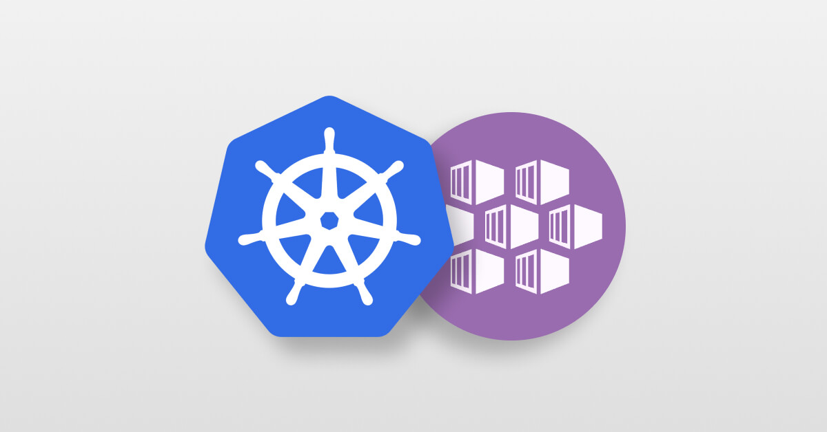
Azure Kubernetes services
What is it ?
Azure AKS is a managed service for running Kubernetes on Azure
Azure AKS can run on Scale Set Virtuals Machine or Containers Instances
Integrates with Gateway, Key Vault, Azure IAM and Azure AD for RBAC
AKS runs the Kubernetes control plane across three AZs to ensure high availability, and automatically detects and replaces unhealthy control plane nodes..

Slide 7
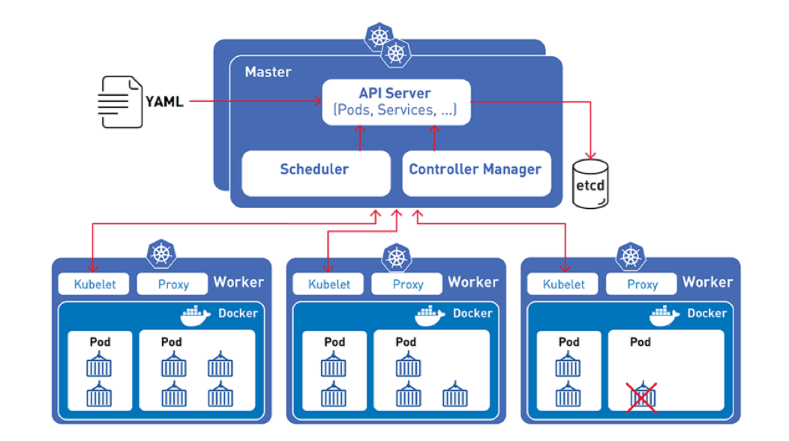
K8S “vanilla” architecture

Slide 8
Advantage of Azure AKS
You don’t have to install, operate, and maintain your Kubernetes control plane.
AKS allows you to easily run tooling and plugins developed by the Kubernetes open-source community.
AKS automates load distribution and parallel processing.
AKS uses Vnet networking.
Any application running on AKS is compatible with one running in your existing Kubernetes environment. You can migrate to AKS without applying any changes to the code.
Supports Containers Instances saves money with per-second pricing and faster deployment

Slide 9
AKS Models
AKS
This operating model is the normal operation of kubernetes with a provisioning of pods with a certain power which makes it possible to manage the financial aspect quite precisely. Scaling can be automatic or manual via AKS node metrics.- The cost is by minutes.
AKS Virtuals nodes
This model is a little different from the first, there is at least one worker node but also virtual pod management that looks a bit like serverless with provisioning via Containers Instances. The cost is by seconds.
AKS Spot
Scenarios such as batch processing and machine learning often do not require guaranteed, on-demand compute availability. With Azure Spot, you can leverage lower-cost compute.

Slide 10
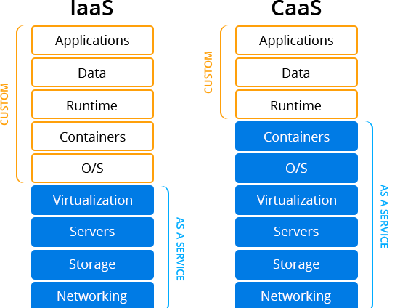
Managed node
Managed (AKS) nodes groups | Self managed nodes
With the AKS-managed node groups, AKS automatically creates and updates data-plane nodes. Users need to click only a couple of buttons on the web console to add new nodes and update the OS or Kubernetes versions. | With the self-managed nodes, users need to create and manage nodes with manual configuration or via Terraform provided by AKS. When the VMs are up and running, they join the Kubernetes control plane. Then, the Kubernetes control plane assigns pods to the nodes and runs containers. In addition, users need to handle the updating of the OS and Kubernetes version of the data-plane nodes.

Slide 11
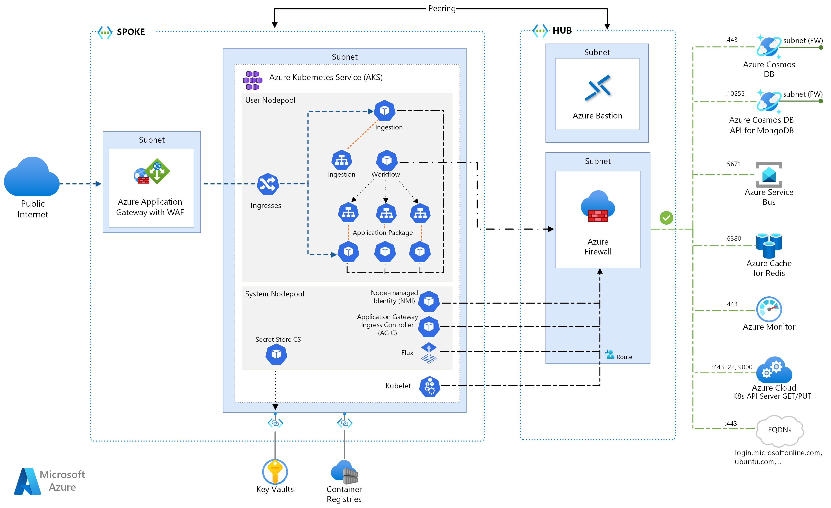
Azure AKS ARCHITECTURE

Slide 12
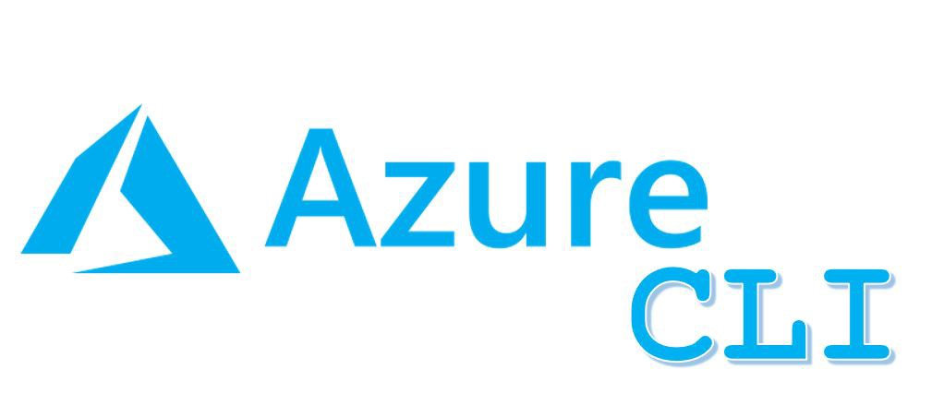
tools
Portal Azure
A web interface for the quick configuration of the cluster but the complete configuration is not available
KUBECTL
Command line tool that you use to communicate with the Kubernetes API server, You must use a kubectl version that is within 2 minor version difference of your Azure EKS cluster control plane.
Azure CLI
The Azure Command Line Interface (Azure CLI) is a unified tool to manage your Azure services. With just one tool to download and configure, you can control multiple Azure services from the command line and automate them through scripts
Terraform
Official providers → Azure, Kubernetes, Helm

Slide 13
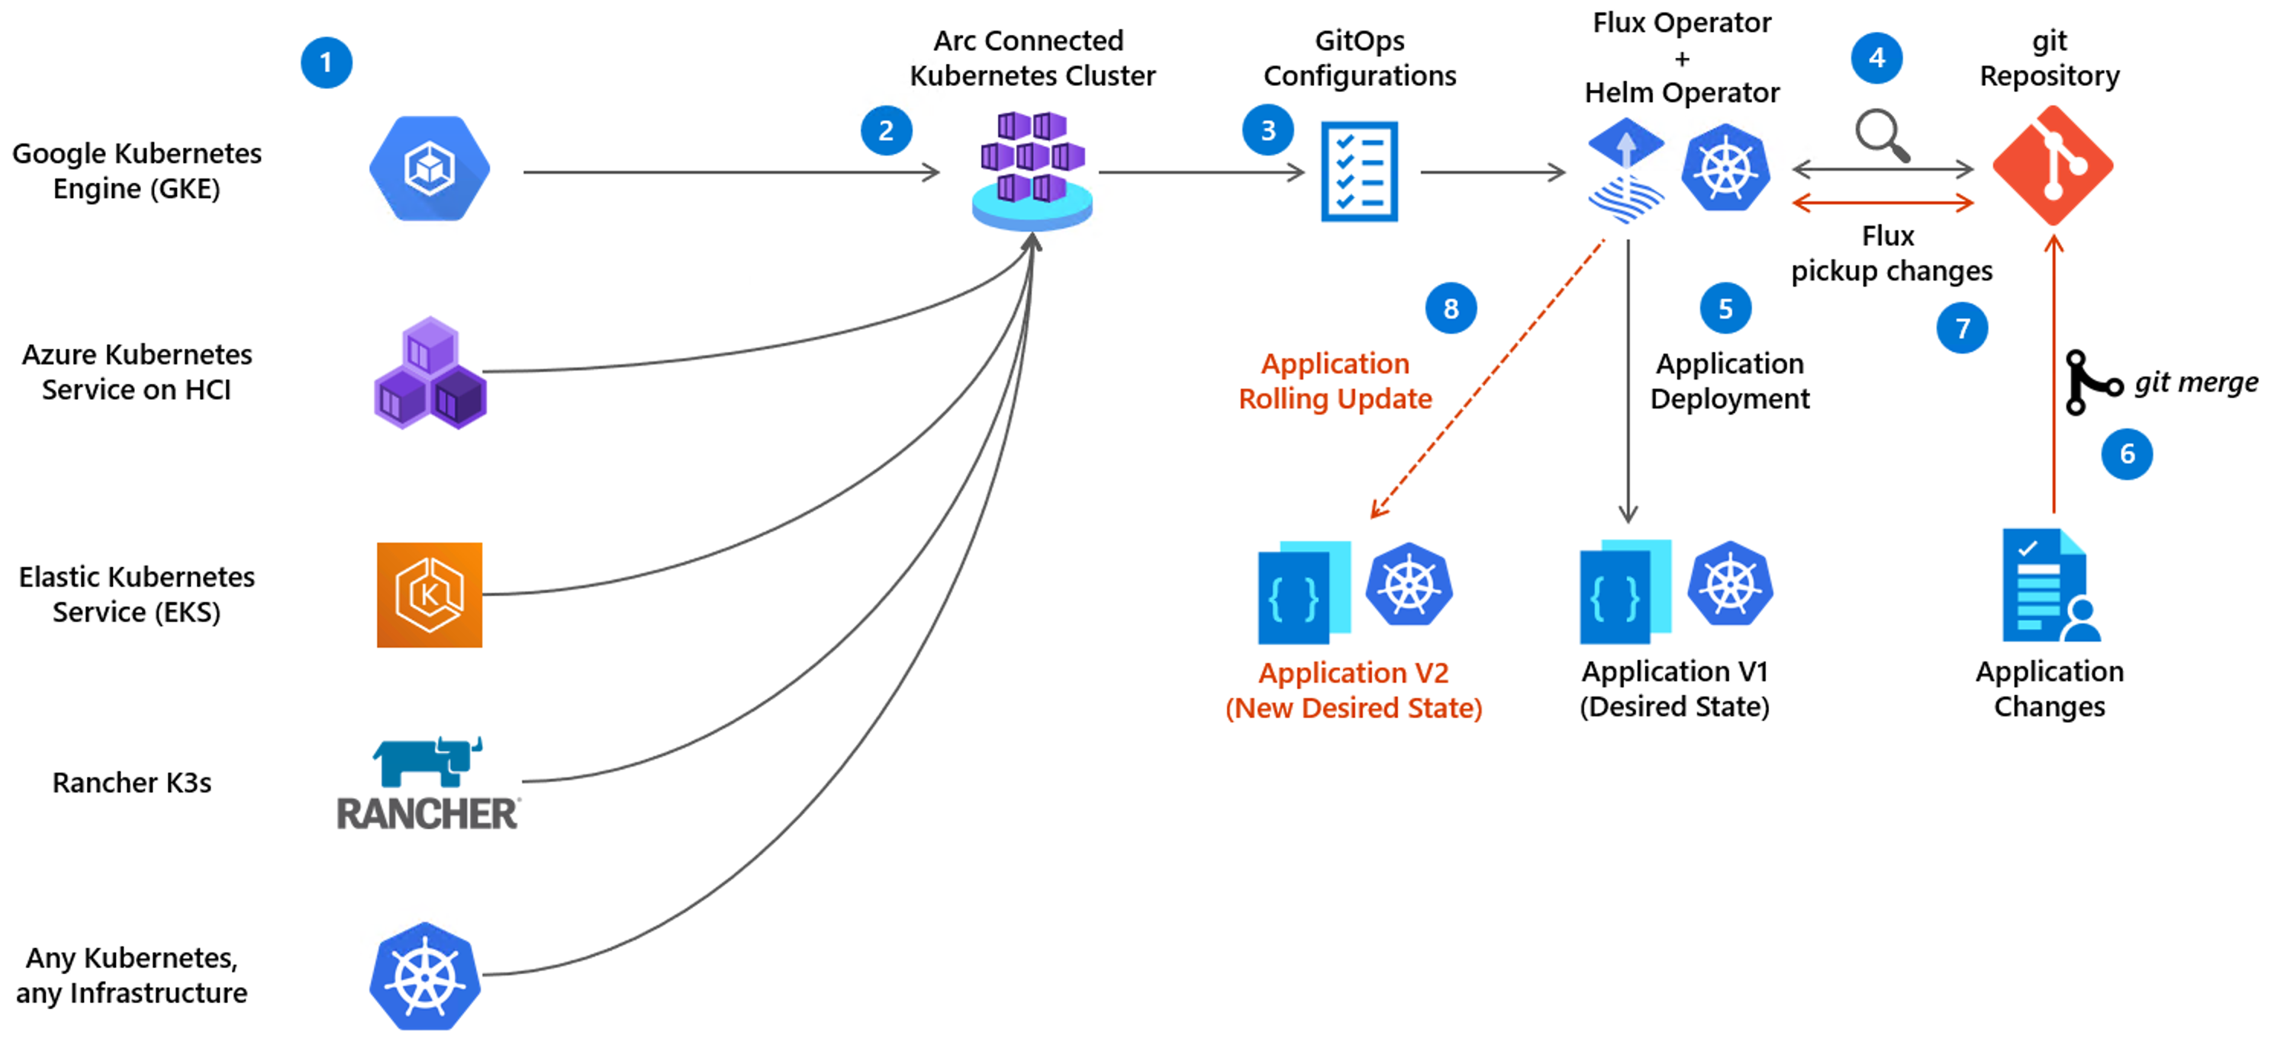
AKS Cluster ARC
Run your Kubernetes cluster on prem’ / AWS / CGP
Support on bare metal servers or using VMware vSphere
Connected Multi-Cloud Cluster

Slide 14
Demonstration

Slide 15
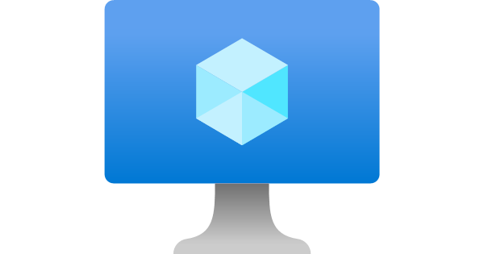
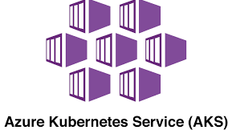
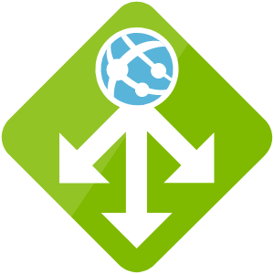

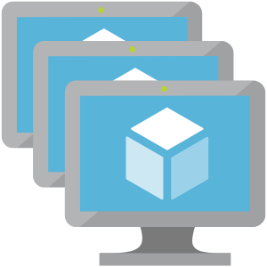
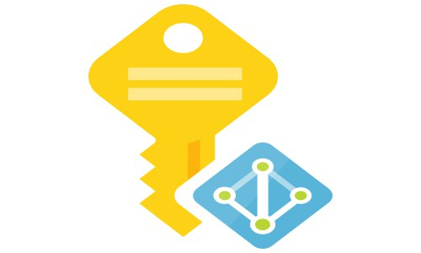
Azure services integration
Virtual Machine
AKS
Gateway
Virtual Network
Virtual Machine Scale Set
Managed Identity
Notes:
eventbridge, cloudtrail…

Slide 16
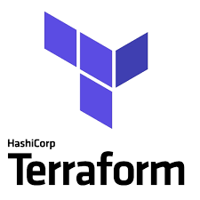
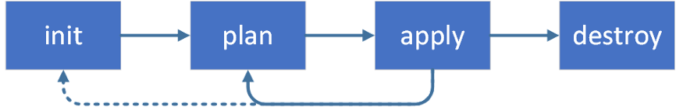
Architecture

Slide 17
practice

Slide 18
Objectif
Dans ce lab vous allez :
Déployer les ressources nécessaires à la création d’un cluster AKS
Configurer une instance AKS et installer les outils pour l’administration d’un cluster AKS et la réalisation du TP :
Kubectl : Outil générique d’administration des clusters K8S
AZ CLI : Outil CLI d’administration d’Azure
GIT : afin de récupérer les manifest K8S (yaml) et les appliquer sur votre cluster AKS.
Déployer un cluster EKS avec 2 worker nodes.
Déployer une application NGINX containérisée.
Ajouter un Key Vault en tant que volume

Slide 19
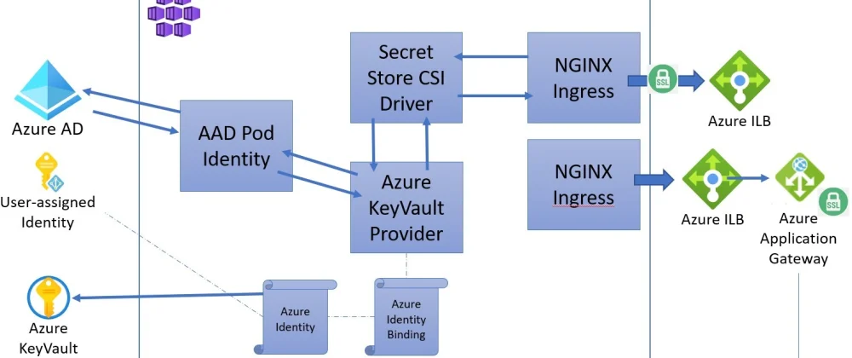
HLD

Slide 20
Comments & feedback

Slide 21
GET THE FUTURE YOU WANT
capgemini.com

Slide 22
About Capgemini
Capgemini is a global leader in partnering with companies to transform and manage their business by harnessing the power of technology. The Group is guided everyday by its purpose of unleashing human energy through technology for an inclusive and sustainable future. It is a responsible and diverse organization of over 325,000 team members more than 50 countries. With its strong 55-year heritage and deep industry expertise, Capgemini is trusted by its clients to address the entire breadth of their business needs, from strategy and design to operations, fueled by the fast evolving and innovative world of cloud, data, AI, connectivity, software, digital engineering and platforms. The Group reported in 2021 global revenues of €18 billion.
Get The Future You Want | www.capgemini.com

